Slide 1
SuiteSpot
Course Team Project, Team 5

Slide 2
Company Name
Meet the team
Nathan Sorensen
Riddhi Bhowmik
Koki Shin
Sergio Calvillo
Aeden Chandy
Eshwar Rajaputana
Roshan Katta

Slide 3
Project Objective
Our objective is to create a modern alternative to traditional vacation home rental websites like Airbnb and Vrbo. We will innovate beyond current norms by streamlining the reservation process, developing a responsive and appealing user environment, enabling precise searches with instant results, and providing an overall seamless booking experience.

Slide 4


Project Schedule
Justification: A three-month timeline allows for complete SDLC execution within the semester constraints.
Jan 20, 2025
Feb - Mar
April 20, 2025
Policy
Start Date Requirements & Architecture
Development Coding & Integration Phase
End Date Testing & Final Deployment
4 Hours/Day Weekdays Only (No Weekends)

Slide 5
Function Point Breakdown
Component | Type | Complexity | FP
User Registration/Login | External Input | Low | 3
Create Rental Listing | External Input | Medium | 4
Search/Filter Listings | External Input | Medium | 4
Booking Property | External Input | Medium | 4
Payment Processing | External Output | High | 7
Messaging (Host/Guest) | External Interface | High | 7
Admin Dashboard | External Output | Medium | 5
Databases (Listings/Users) | Internal Logical File | High/Med | 17
Total Adjusted FP | (VAF 1.1) | — | 72

Slide 6
Cost & Effort Summary
Total Function Points 72 FP
Estimated Effort (10hr/FP) 720 Hours
Labor Cost ($35/hr) $25,200
Hardware/Cloud $500
Software/Training $420
Estimated Final Price (with Overhead) = $28,980

Slide 7
Project Timeline
Goal
Setup
Backend Foundation
Frontend Build:
Testing
Define requirements and set up the Github repo and coding environment
Build the User and Listing databases and create the core API structure.
Develop the UI screens for Login, Search, and Booking, and connect them to the database.
Test the booking and mock payment features to simulate the final experience
A working prototype ready that can simulate the final product

Slide 8
Functional & Non-Functional Requirements
Functional Requirements | Non-Functional Requirements
Authentication: Secure Sign-up & Login. Search Engine: Filter by Location, Dates, & Guests. Booking System: Secure Payments & Email Confirmations. Listing Management: Hosts can Add, Edit, or Delete properties. Host Dashboard: View upcoming reservations. User Profile: Manage Wishlists & Saved Homes. | Technical & Quality Goals Usability: Responsive design (Desktop & Mobile). Performance: Search results load in < 2 seconds. Reliability: Target 99% uptime during demo. Portability: Compatible with modern browsers (Chrome/Edge). Tech Stack & Standards Stack: MERN (MongoDB, Express, React, Node.js). Workflow: GitHub for version control; REST API standards. Code Quality: ESLint for code style and linting. Compliance & External Security: Basic data privacy, mock integration for payments.

Slide 9
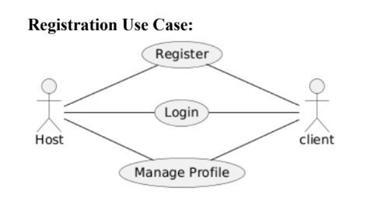
Use Case Diagram

Slide 10
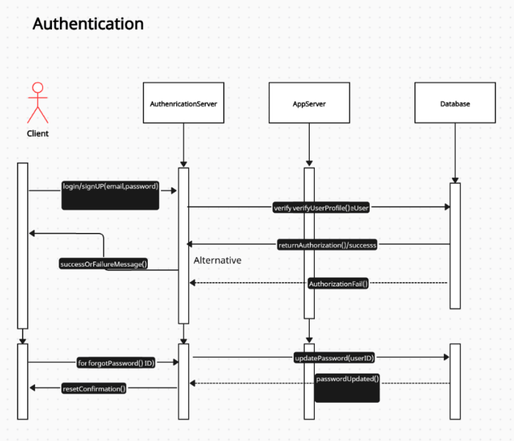
Sequence Diagram
The Client sends the email and password to the Authentication Server. The Server doesn't store passwords locally; it queries the Database to verify the profile.
If the database returns a match, we send a success token. If not (the dashed arrow you see here), we return a failure message to the UI so the user knows to retry.
We also accounted for password resets. The client sends a request, and the server updates the record in the database.
We separated the App Server from the Auth Server to ensure our application is modular and secure

Slide 11
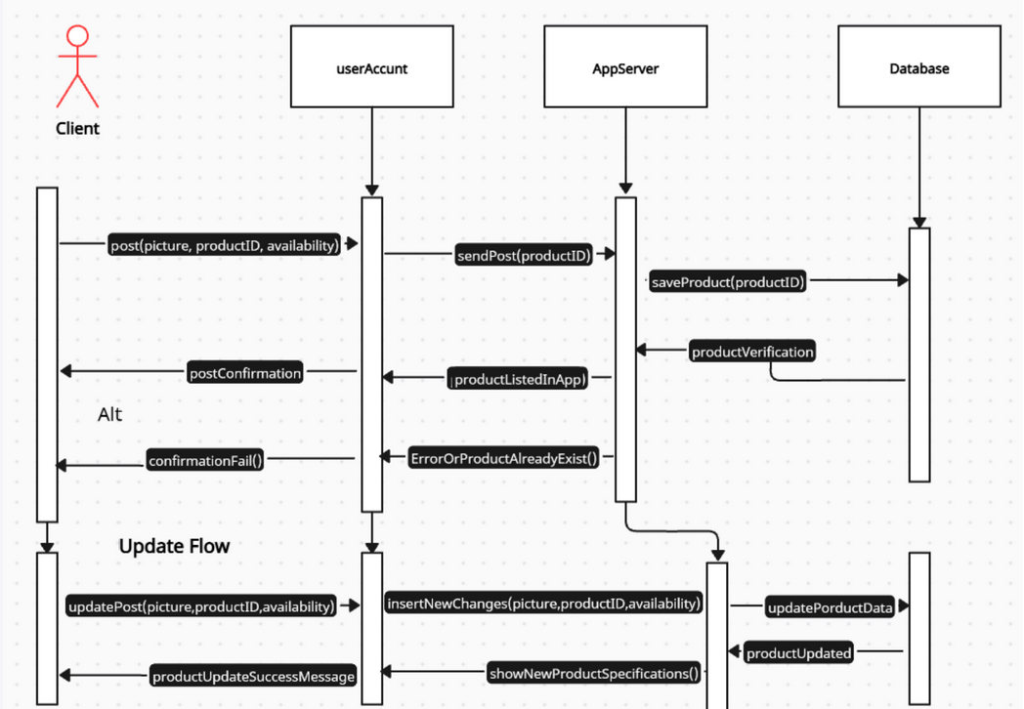
Listing Management sequence diagram
The Client submits the picture and availability.
Our AppServer acts as a gatekeeper—it doesn't just save blindly. It first validates the data.
If the listing already exists or the data is corrupt, the Database rejects it, and we bubble that error up to the user immediately.
If valid, the database generates a unique ID, and we confirm the listing is live.

Slide 12
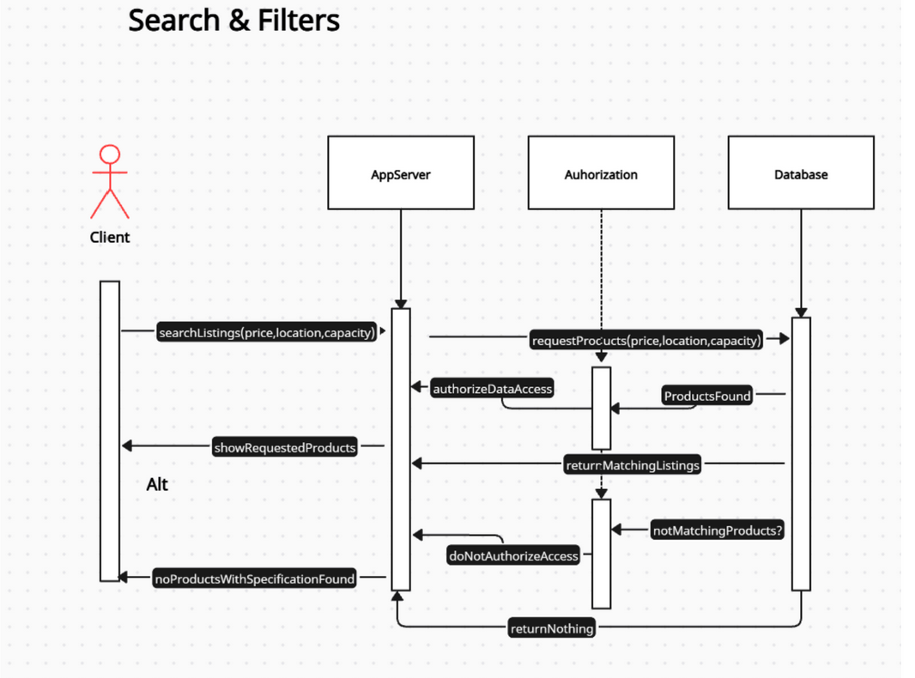
The Client sends the filter parameters price, location, and capacity to the App Server.
The App Server constructs a query and sends it to the Database.
If matches found the database returns a list of objects and the app server processes these and returns them to the user.
If no matches it returns an empty list and the app server then triggers a specific UI response prompting the user to adjust their filters.

Slide 13
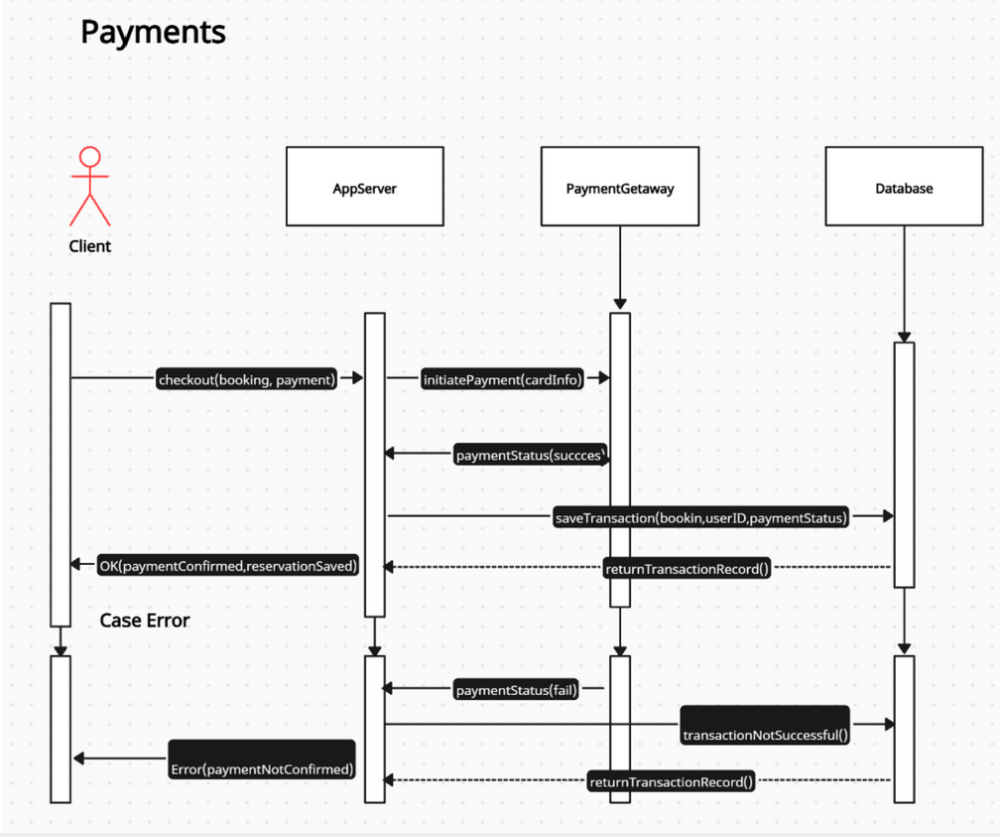
The Client sends the booking details and payment credentials.
Our app server immediately forwards this data to the external payment gateway.We do not process the money ourselves.
If the Gateway returns 'Success', we commit the transaction to our Database and confirm the booking to the user.
If the bank declined the card, we still talk to the Database. We log the failed attempt to create an audit trail, ensuring we can debug why transactions are failing.

Slide 14
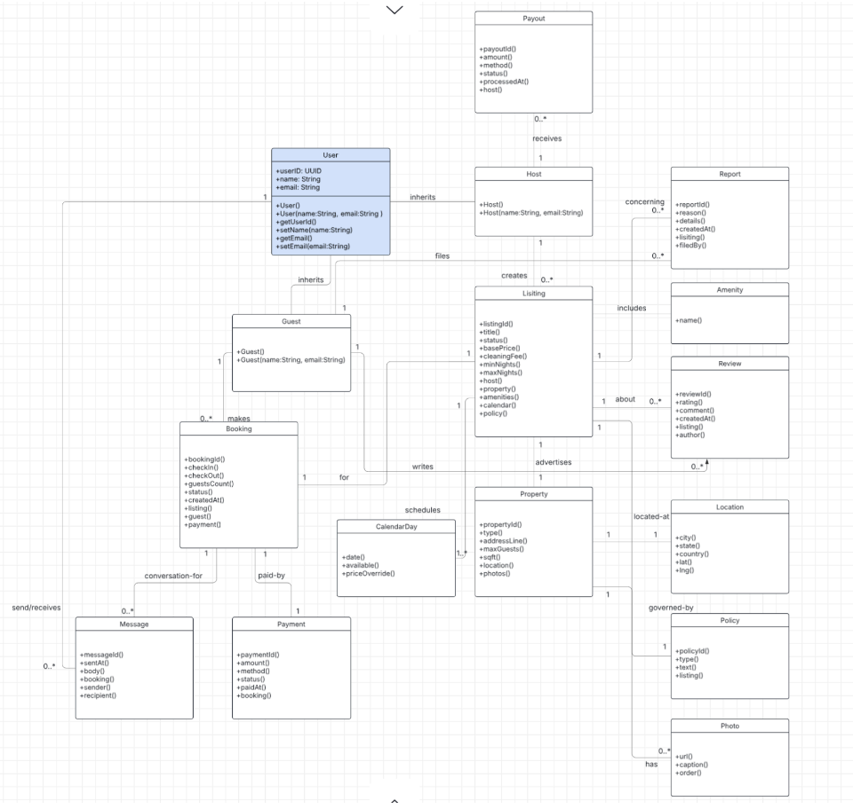
Class Diagram
This UML diagram outlines our online home rental marketplace application’s key
classes and their relationships. At its core, the diagram models 3 user types: User that
has the specialized classes for Host & Guest. The Host class is able to create
Listings that advertise Properties at a specific Location. Additionally, each Listing
may have multiple Photos, Amenities, and CalendarDays, and is governed by a
Policy. Guests are able to interact with Listings by making Bookings, which are
associated with Payments and Messages. Bookings may also trigger Reviews that
are written by the Guests and Reports filed against Listings. Hosts will receive
Payouts based on their Listings’ activities. The model captures the structuring of the
marketplace, from user interaction to property management and transaction flows.

Slide 15
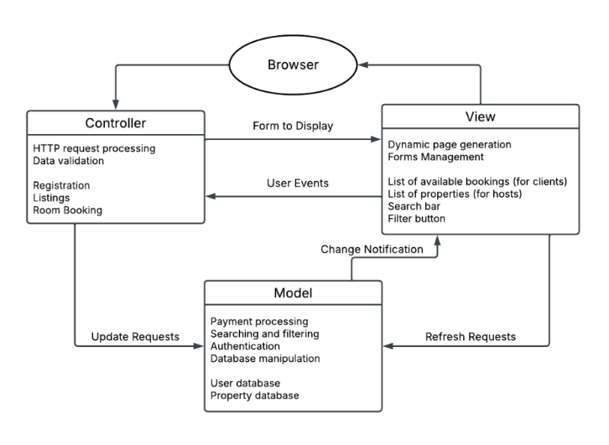
Architectural Design
We’re choosing to use the MVC architectural pattern. It allows us to provide different views of the data to hosts and clients in order to fit each of their needs. It also gives us the flexibility to adapt to future requirements that we aren’t currently aware of. Since our system is a web-based service application, the architectural model builds off of the web-based application model.

Slide 16
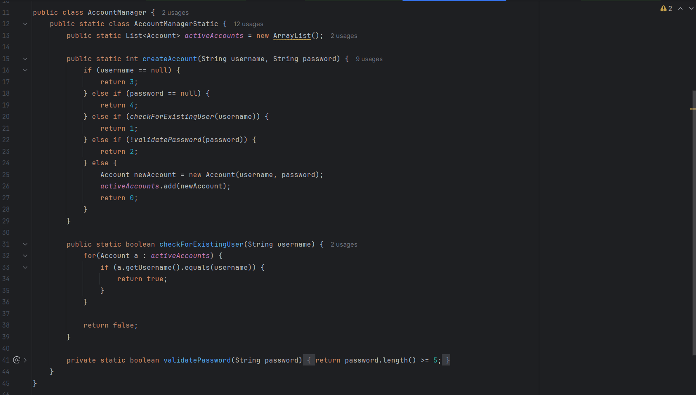
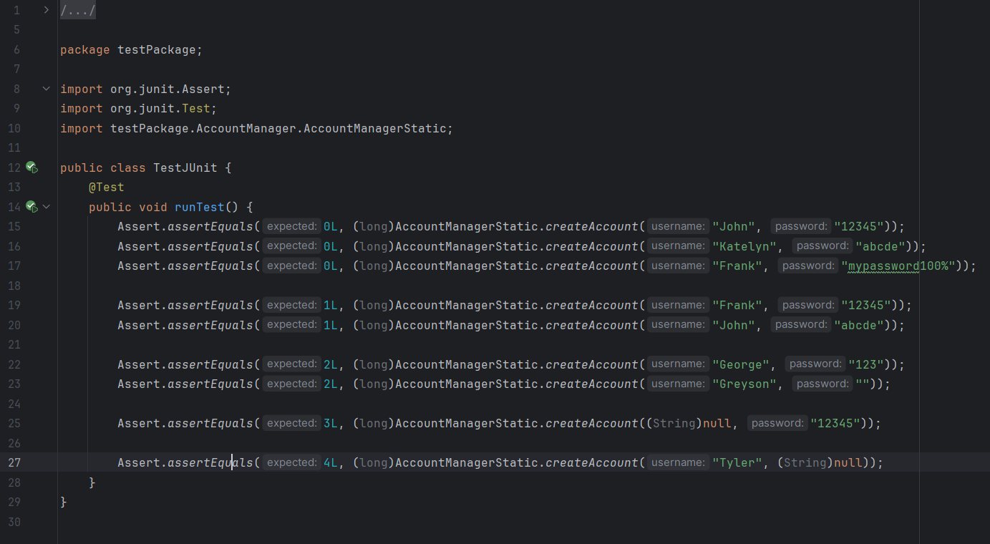
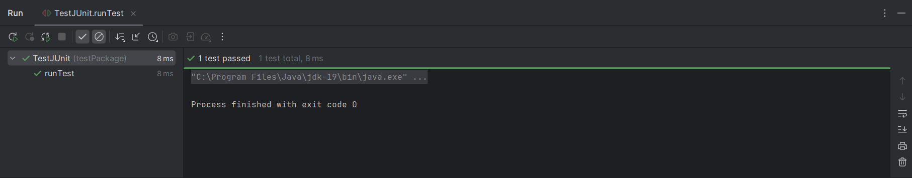
Unit Testing
As shown here, we did some simple unit testing, where we attempted to make new accounts with valid credentials, then try to create a duplicate user, then try to set an invalid password, and finally attempt to create an account that is missing either a username or a password. As seen, the test passes, since the error codes returned by each output align with how we defined them in our AccountManager file.

Slide 17
Comparison with Similar Designs
Feature | Vrbo | Airbnb | SuiteSpot
Accommodation Type | Entire homes only. Focused on traditional vacation spots (family/groups). | Diverse. Rooms, shared spaces, entire homes, unique stays | Curated Entire Homes: Vetted, high-quality properties with consistent, professional service.
Search/Filtering | Good, dedicated filters. Filters are primary. | Uses filters and Categories for discovery. | Semantic Search (AI-Driven): Search by experience (e.g., "quiet cabin with hot tub"). Instant, precise results.
Pricing Display | Guest service fees added at checkout. | Guest service fees added late in the process (the "Surprise Fee"). | All-Inclusive Upfront Pricing: Total, final price displayed in search results for complete transparency.
Booking Process | Often requires a booking request (host approval). Less instant. | Mostly Instant Book, but still relies on host interaction/messaging. | Seamless & Instant: Automated, one-click booking with digital check-in integration.
Guest Communication | Less frequent, more formal (email-based messaging). | In-app messaging (host-to-guest). Support is often through the host. | Digital Concierge: Automated in-app support for common needs + 24/7 centralized human support.
UI/UX Approach | More traditional/functional; filter-heavy. | Visually appealing, dynamic, and mobile-friendly; discovery-focused. | Mobile-first, responsive design focusing on streamlined workflow and fewer clicks to confirmation.
Core Value | Privacy, space, and family-focused vacation stays. | Variety, budget options, and unique local experiences. | Seamless Experience, Guaranteed Quality, and Personalized Search.

Slide 18
Any questions?
Ask away!

Slide 19
Thank you

